Slide 1
Registers
Reference
Chapter 7
Moris Mano 4th Edition

Slide 2
Types of Registers
Registers with Parallel Load
Simultaneously loading all bits from external input
Shift Registers
Register which can shift its stored bits in one or both directions
One bit (external input) being saved at a time

Slide 3
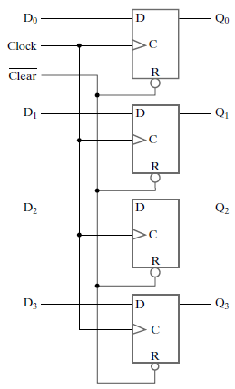
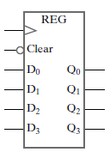
4-bit Register with parallel load
Symbol
Register Contents:
Q3 | Q2 | Q1 | Q0
Logic Diagram
Notes:
Page 337 Moris Mano 4th Edition

Slide 4

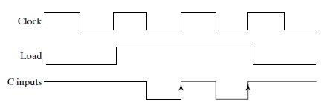
1. Load Control with Clock Gating
C Input
Clock stopped
Behind the gate
Clock being passed
To register
Notes:
Page 337 Moris Mano 4th Edition

Slide 5
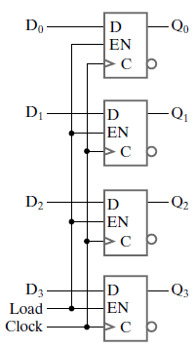
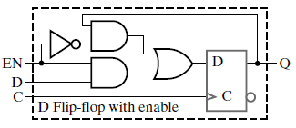


2. Load Control with D Input
Clock
Notes:
Page 339 Moris Mano 4th Edition

Slide 6
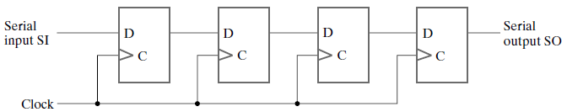
What is this block doing?
Clock

Slide 7
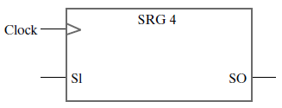
Shift Register
Symbol
External Input
Clock
Notes:
Page 353 Moris Mano 4th Edition

Slide 8
How Shift Register works?
Given:
Serial Input = 0 (constant)
Initial Value of Register = 1010
What will be the value of register after T1, T2, T3 and T4?
0
1
0
1
0
Clock
Positive Edge Triggered D Flip-Flop: Q(t+1) = D(t)

Slide 9
How Shift Register works?
Given:
Serial Input = 0 (constant)
Initial Value of Register = 1010
What will be the value of register after T1, T2, T3 and T4?
0
0
1
0
1
Clock

Slide 10
How Shift Register works?
Given:
Serial Input = 0 (constant)
Initial Value of Register = 1010
What will be the value of register after T1, T2, T3 and T4?
0
0
0
1
0
Clock

Slide 11
How Shift Register works?
Given:
Serial Input = 0 (constant)
Initial Value of Register = 1010
What will be the value of register after T1, T2, T3 and T4?
0
0
0
0
1
Clock

Slide 12
How Shift Register works?
Given:
Serial Input = 0 (constant)
Initial Value of Register = 1010
What will be the value of register after T1, T2, T3 and T4?
0
0
0
0
0
Clock

Slide 13
Homework
Can you design a register which shifts the data left?

Slide 14
Parallel vs Serial Mode
Digital System is said to operate in “Parallel Mode” when all the bits are transferred or manipulated at a time.
Digital System is said to operate in “Serial Mode” when information in the system is transferred or manipulated one bit at a time.

Slide 15
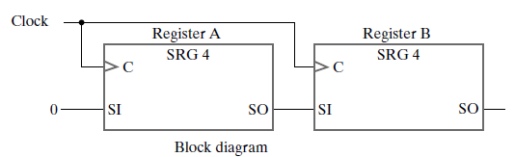
What is this block doing?
Clock

Slide 16
Serial Transfer
Clock
Notes:
Page 375 Moris Mano 4th Edition

Slide 17
How Serial Transfer Works?
Given:
Initial Value of Register A = 1011
Initial Value of Register B = 0010
What will be the value of both registers after T1, T2, T3 and T4?
Clock

Slide 18
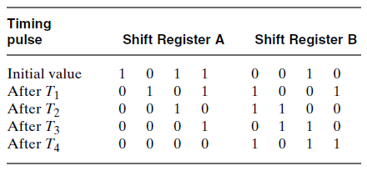
How Serial Transfer Works?
Clock
After T4:
B = A
A = 0

Slide 19
Homework
What if after T4 we want:
B = A and A = A
Or
B = A and A = B
Or
B = A and C = B and A = C

Slide 20
Serial Transfer with Shift Control
Requirement:
If Shift = 1 → Transfer Contents of registers
If Shift = 0 → Retain data
How will you implement this functionality?

Slide 21
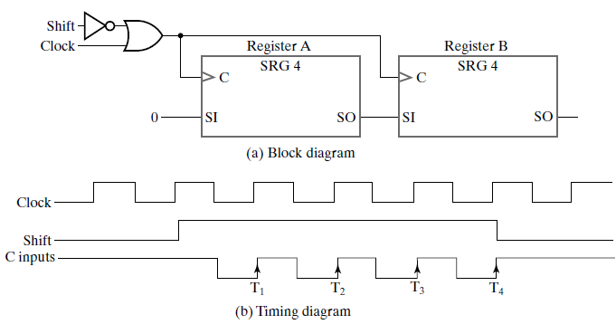
Serial Transfer with Shift Control
Notes:
Page 375 Moris Mano 4th Edition

Slide 22
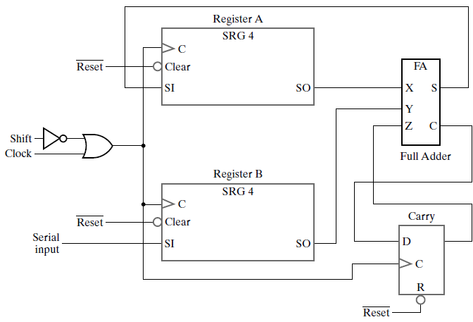
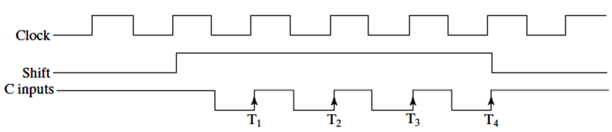
What is this block doing?
A3A2A1A0
B3B2B1B0
Notes:
One pair of significant bits (Ai, Bi) is being added at one clock pulse. Page 377 Moris Mano 4th Edition

Slide 23
Serial Addition
Why are we saving carry in flip-flop?
A3A2A1A0
Si
C(i+1)
B3B2B1B0
Notes:
Page 377 Moris Mano 4th Edition

Slide 24
Homework
How can you perform following functionality using the Serial Addition Circuit (without changing the circuit)?
A = A + B + C + D

Slide 25
Shift Register with Parallel Load
Requirements:
Design a register which
Behaves like a shift register, if Shift = 1
Behaves like register with parallel load, if Load = 1
Retains data, if Shift = 0 and Load = 0
Notes:
Page 354 Moris Mano 4th Edition

Slide 26
Shift Register with Parallel Load
Requirements:
Design a register which
Behaves like a shift register, if Shift = 1
Behaves like register with parallel load, if Load = 1
Retains data, if Shift = 0 and Load = 0
Shift | Load | Operation
0 | 0 | No Change(Hold)
0 | 1 | Load Parallel Data
1 | X | Shift down from Q0 to Q3
Notes:
Page 354 Moris Mano 4th Edition

Slide 27
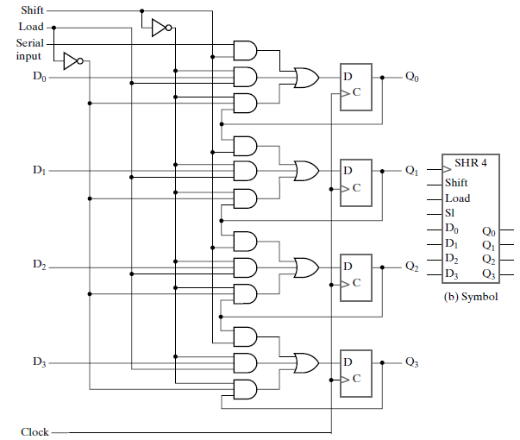
Shift Register with Parallel Load

Slide 28
1
1
Enabled
When Shift = 1
Shifting data right
0
0
0
Enabled
0
0
Enabled
0
0
Enabled
0
0

Slide 29
0
Enabled
1
1
Load = 1 & Shift = 0
Parallel Load Data
0
0
0
Enabled
0
0
Enabled
0
0
Enabled
0
0

Slide 30
0
0
Enabled
Load = 0 & Shift = 0
Retain previous data
0
0
Enabled
0
0
Enabled
0
0
Enabled
0
0

Slide 31
What is this circuit
Doing when
Load = 1 & Shift = 1
???

Slide 32
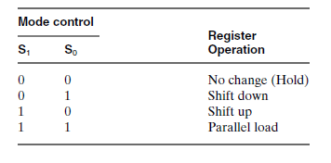
Design a register with following requirements
Q3 | Q2 | Q1 | Q0
(Or Shift Left)
(Or Shift Right)
Function Table
Notes:
Function table of Bidirectional shift register with Parallel Load

Slide 33
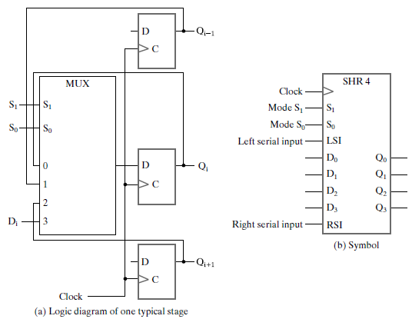
What is this Circuit doing?
Notes:
This is Bidirectional Shift Register with parallel Load. Page 355 Moris Mano 4th Edition

Slide 34
What is this Circuit doing?
0
0
Qi(t+1) = Qi(t)
Retain Previous Data

Slide 35
What is this Circuit doing?
0
1
Shift Left (or Shift Down)

Slide 36
What is this Circuit doing?
1
0
Shift Right (or Shift Up)

Slide 37
What is this Circuit doing?
1
1
Parallel Load

Slide 38
Bidirectional shift register with Parallel Load

Slide 39
Bidirectional shift register with Parallel Load
Make flip-flop level full circuit of 4-bit Bidirectional Shift Register with Parallel Load

Slide 40
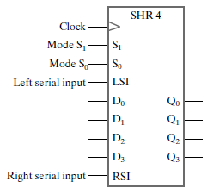
What will be the Serial Output for Bidirectional Shift Register?

Slide 41
What will be the Serial Output for Bidirectional Shift Register?
Serial Out For Shift Left

Slide 42
What will be the Serial Output for Bidirectional Shift Register?
Serial Out For Shift Right

Slide 43
Serial In – Parallel Out Register
Design yourself

